Slide 1
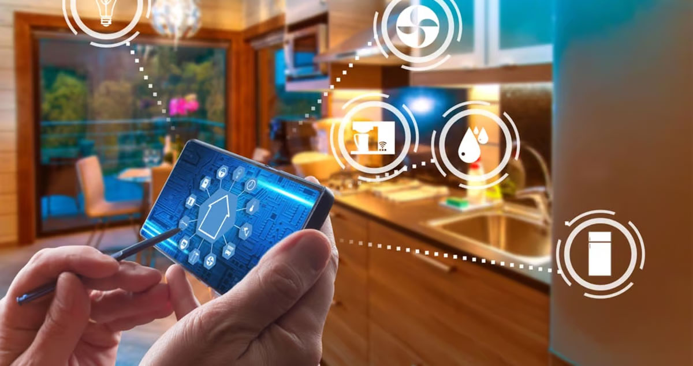
I O T

Slide 2
Internet
Of
Things

Slide 3
Internet Of Things
Applications
S M A R T H O M E

Slide 4
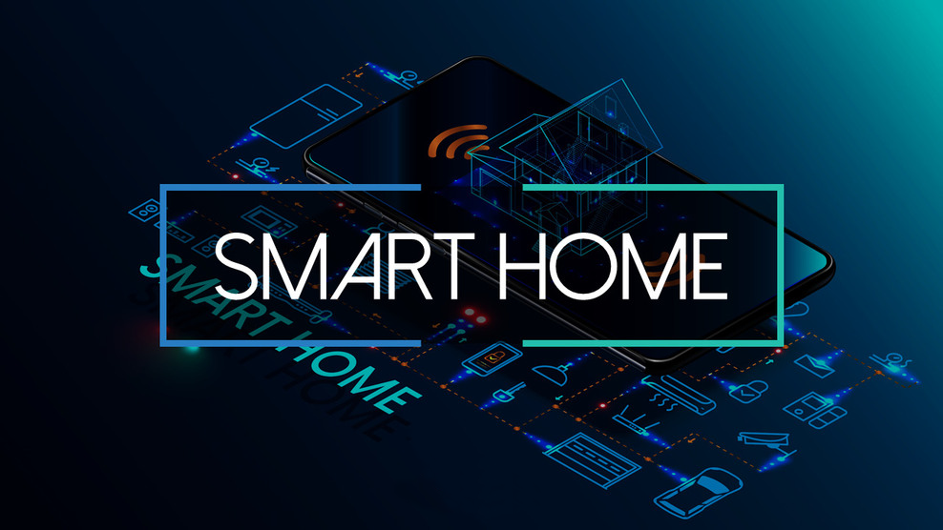
Introduction:
Smart home is a new concept that involves using modern technology to make homes more comfortable, safe, and efficient
It is a network of connected devices that exchange data and work together to achieve certain tasks

Slide 5
Energy saving
Better comfort
and control
Benefits of smart home:
Improved security
Smart systems can reduce energy consumption by automatically controlling lighting, heating and cooling
Home appliances can be controlled via mobile apps or voice commands
Smart security systems such as cameras and sensors provide additional home security
1.
2.
2.
3.
1.
3.

Slide 6
Smart home components:
1- Sensors:
measure various conditions such as movement, temperature and humidity
2- Connected appliances:
include lights, refrigerators, washing machines, etc
3- Central control system:
such as smartphones or tablets that control all connected devices

Slide 7
Internet of Things applications in smart homes:
1- Lighting control:
Lights can be turned on and off automatically or remotely
2- Security and surveillance systems:
Surveillance cameras, door and window sensors
3- Temperature control:
Smart thermostats adjust temperature based on preferences

Slide 8
Conclusion:
Continuous technology development will make smart homes more efficient and convenient.
This should be the general trend in the future.

Slide 9
Created by: Ahmed Serag
Thank you

